Slide 1
Chris Colbert, Jupyter
Steven Silvester, Quansight
Afshin Darian, Jupyter
Ian Rose, Berkeley
Jason Grout, Bloomberg
Brian Granger, Cal Poly
Jessica Forde, Jupyter
Grant Nestor, Cal Poly
Cameron Oelsen, Cal Poly
Fernando Perez, LBNL/Berkeley
Cal Poly Interns
The Larger Jupyter Team
@jupyterlab on GitHub
@ProjectJupyter on Twitter
JupyterLab:
The Evolution of the Jupyter Notebook
Vidar Tonaas Fauske, Simula

Slide 2
The Jupyter Notebook

Slide 3
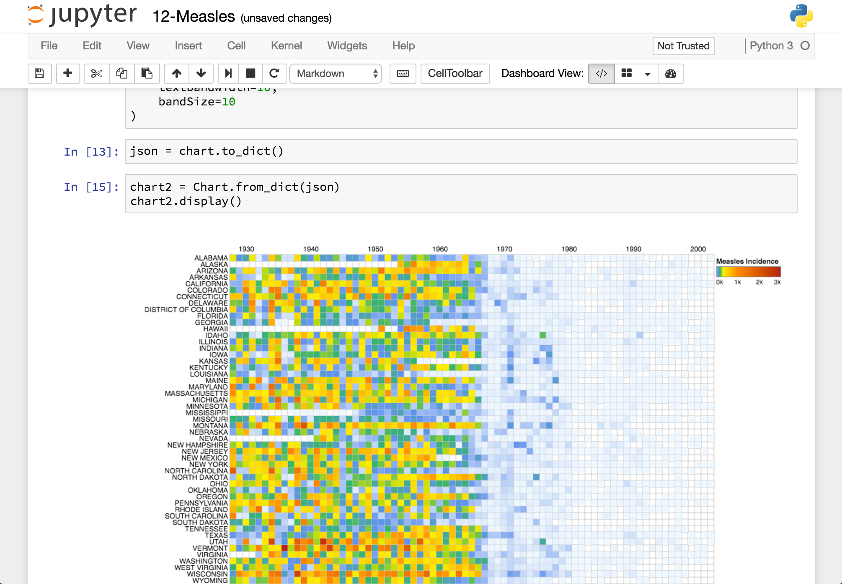
Jupyter
Notebook
A Jupyter Notebook document with a visualization of measles data.

Slide 4
Interactive, Exploratory, Reproducible
Interactive, browser-based computing environment
Exploratory data science, ML, visualization, analysis, stats
Reproducible document format:
Code
Narrative text (markdown)
Equations (LaTeX)
Images, visualizations
Over 50 programming languages
Everything open-source (BSD license)
Jupyter
Notebook

Slide 5
Project Jupyter: Where are we today?

Slide 6
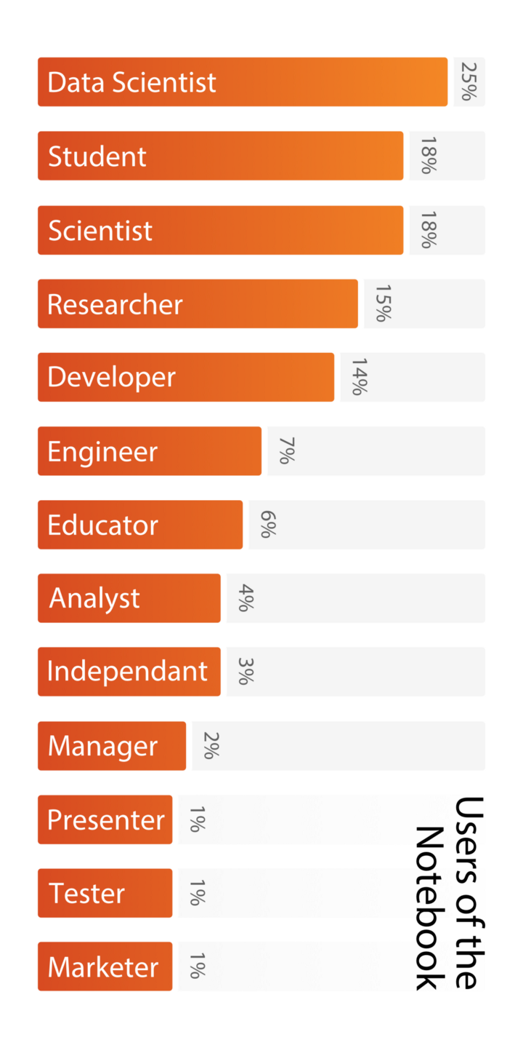
Millions of Users
https://github.com/jupyter/design/blob/master/surveys/2015-notebook-ux/analysis/report_dashboard.ipynb

Slide 7
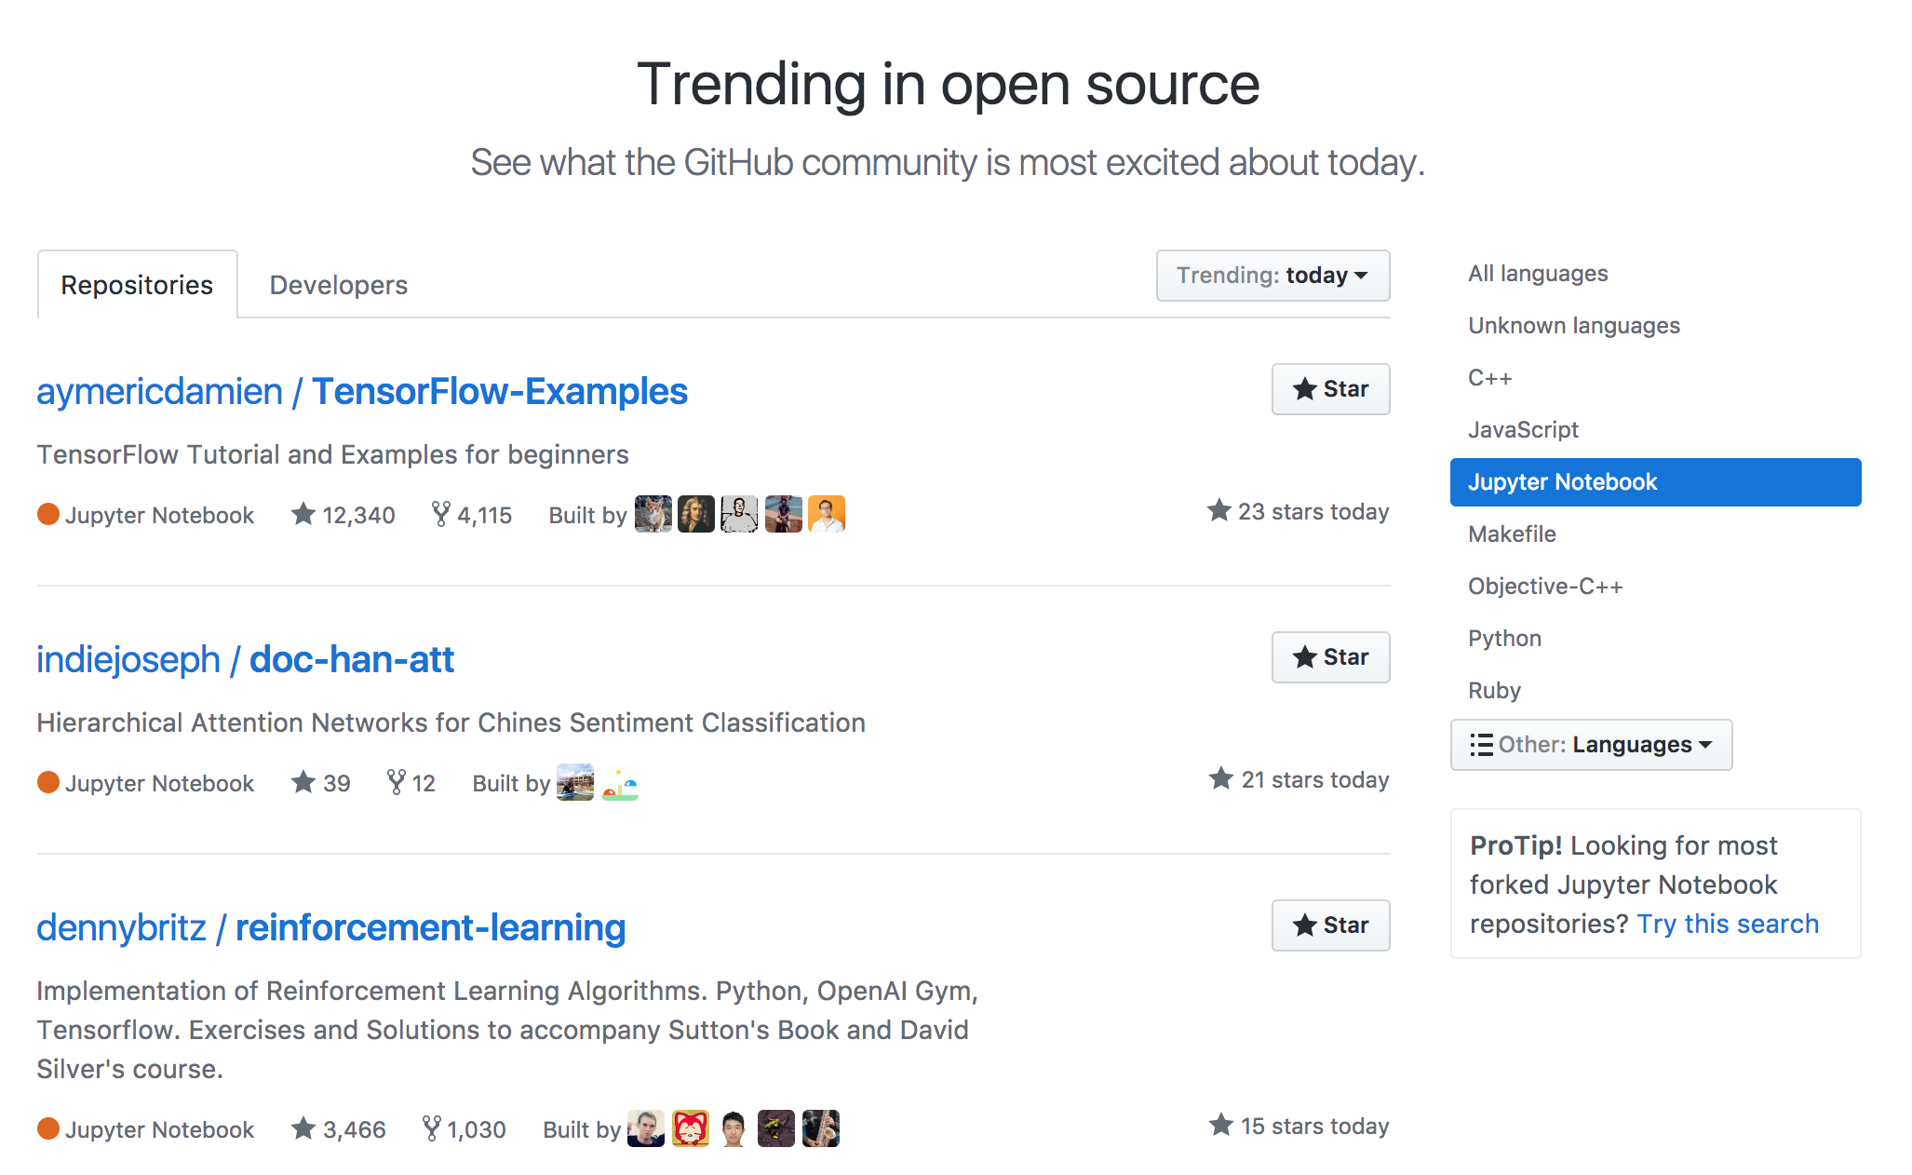
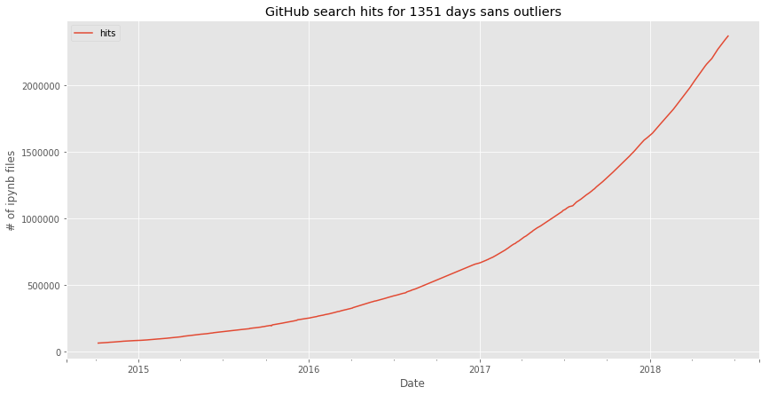
Millions of Notebooks
https://github.com/trending/jupyter-notebook
https://github.com/parente/nbestimate

Slide 8
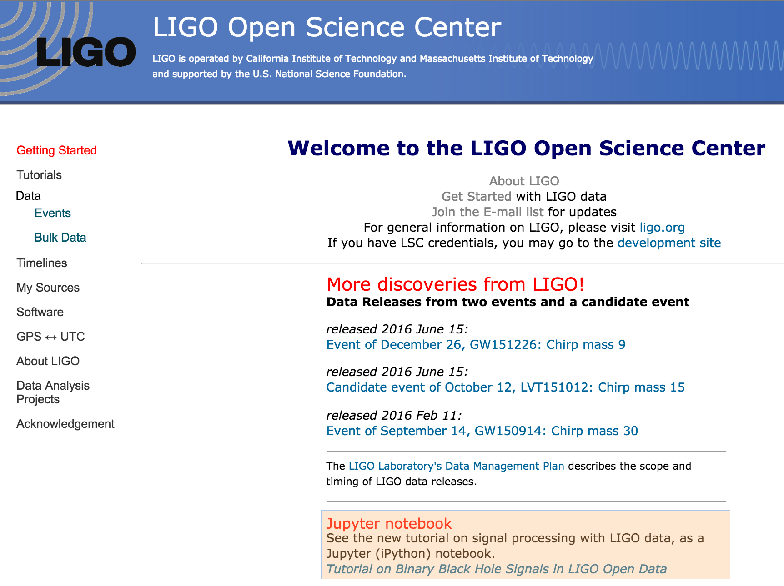
Enabling
Reproducible
Science
https://losc.ligo.org/about/

Slide 9
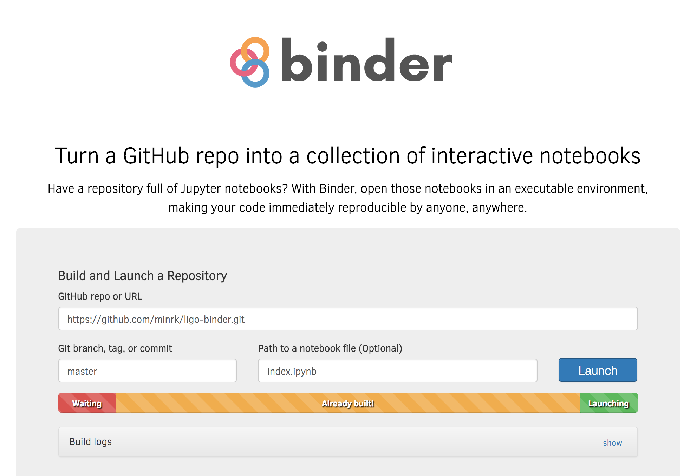
LIGO Binder
Live Code on
Binder
https://losc.ligo.org/tutorials/
https://beta.mybinder.org/v2/gh/minrk/ligo-binder/master?filepath=index.ipynb

Slide 10
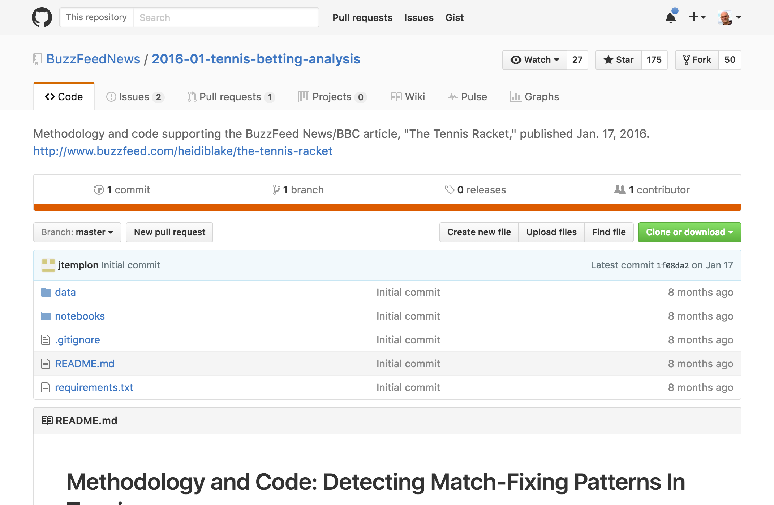

Enabling
Open Data
Journalism

Slide 11

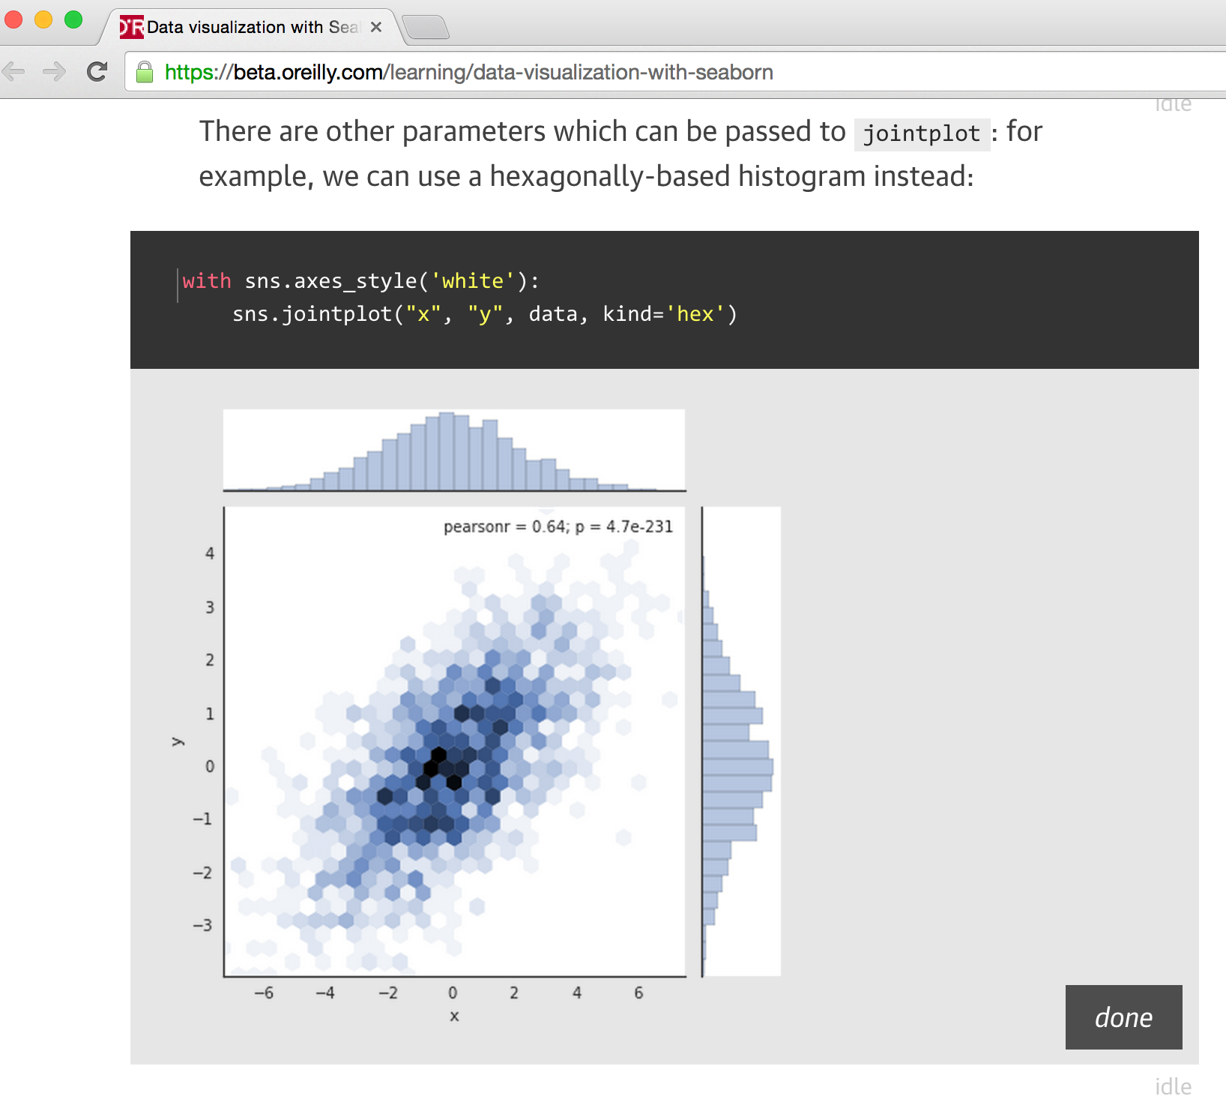
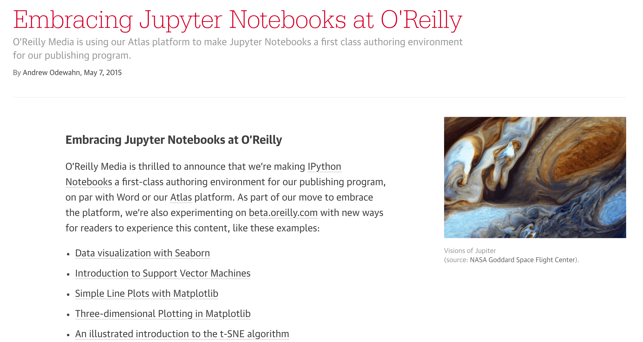
Authoring
Interactive Books
O’Reilly Atlas authoring platform incorporating live code
https://www.oreilly.com/ideas/jupyter-at-oreilly

Slide 12
Building Blocks for Interactive Computing

Slide 13
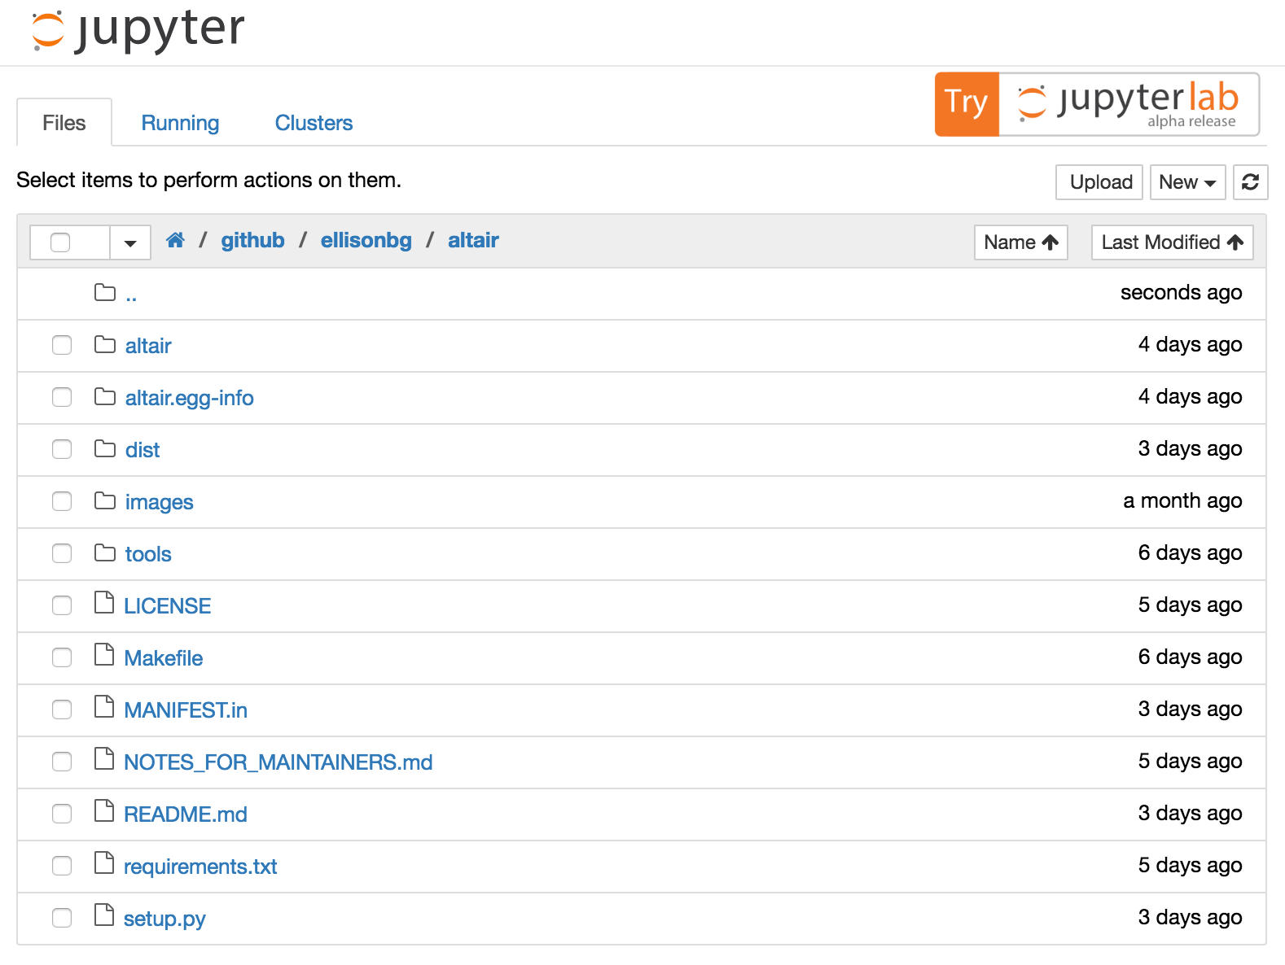
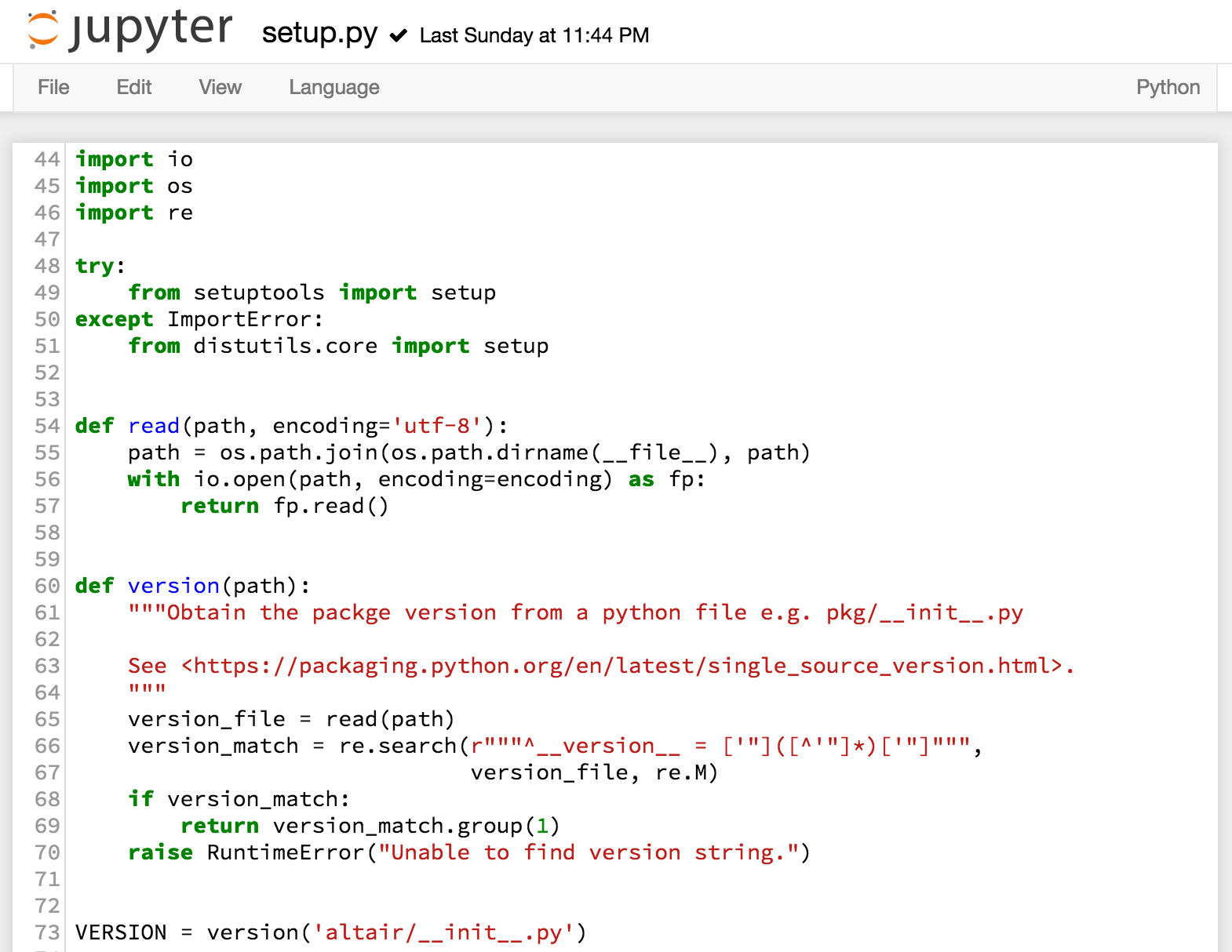
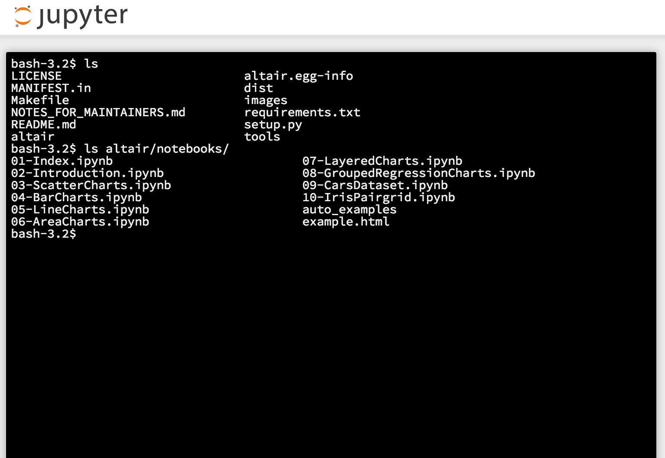
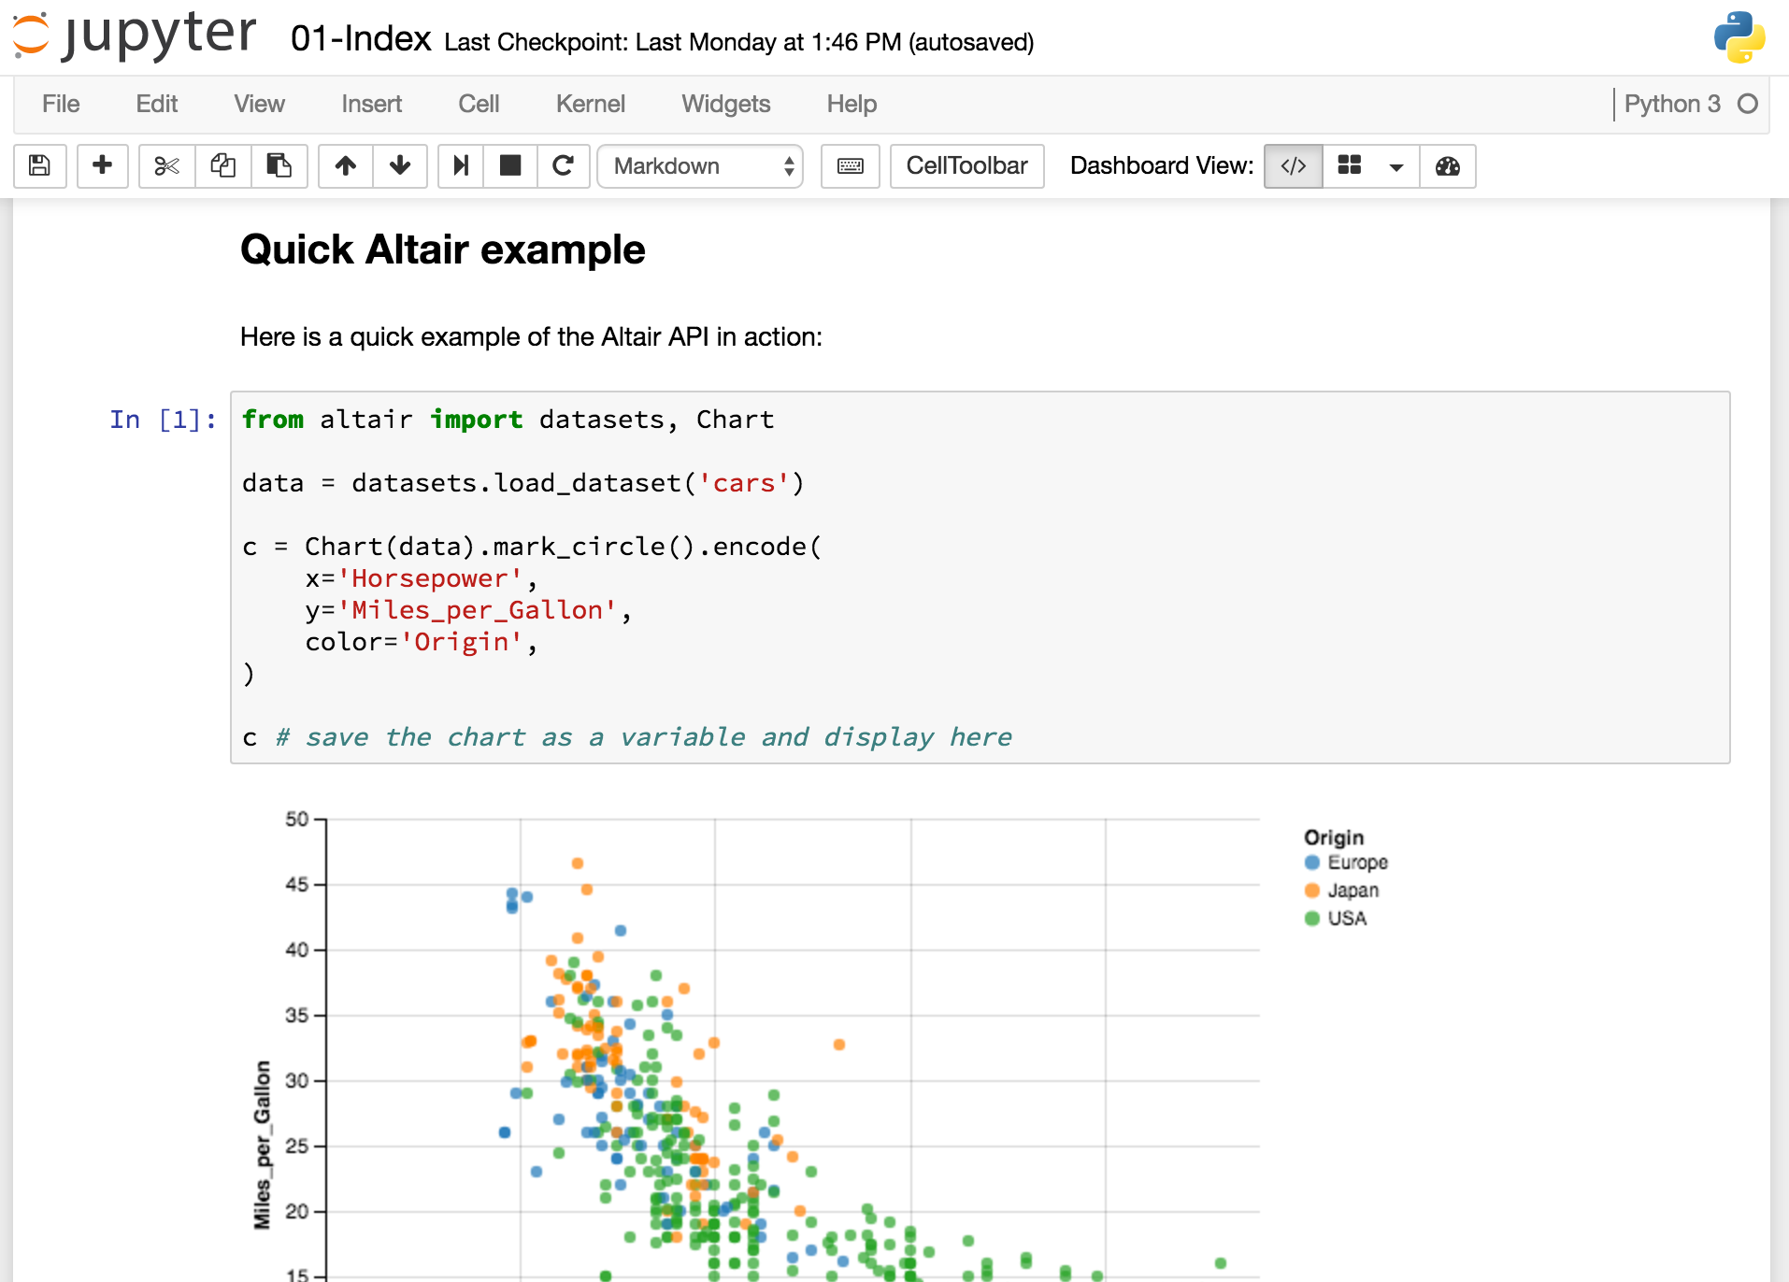
Classic Jupyter: More Than Just Notebooks

Slide 14

File Browser
Notebooks
Terminal
Text Editor
Building
Blocks
Kernels
Output

Slide 15
Introducing JupyterLab

Slide 16
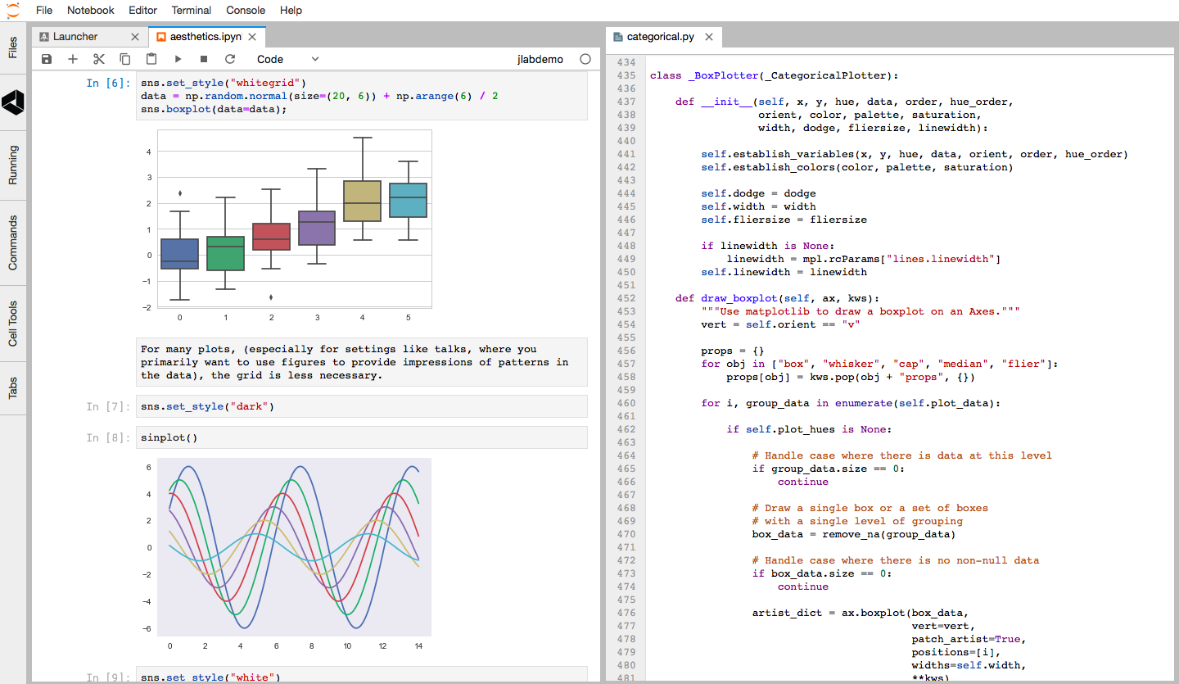
JupyterLab: Integrated Experience

Slide 17
Building Blocks
Work with the building blocks in a flexible and integrated manner
Modern JavaScript development: npm-based packaging, Typescript, phosphor.js
Clean model/view separation
Well separated public/private APIs
Fully extensible by third parties
High performance
Design!
JupyterLab

Slide 18
JupyterLab Today
https://github.com/jupyterlab
~3 years worth of development
~100 contributors, ~60 components
~2,500 releases (npm+python)
Over 12,000 commits, ~classic notebook
Currently Beta
July
2018

Slide 19
JupyterLab Beta: Use It Today
conda install -c conda-forge jupyterlab
or pip install jupyterlab
Beta releases, January 2018, Beta 3 in July
For all users
For adventurous extension developers
1.0 this year
For all users, extension developers
Eventually:
Classic notebook will be retired
Roadmap

Slide 20
Live Demos!

Slide 21

JupyterCon, Aug 21-25, New York
Thank You!
conda install -c conda-forge jupyterlab
or pip install jupyterlab

